Slide 1
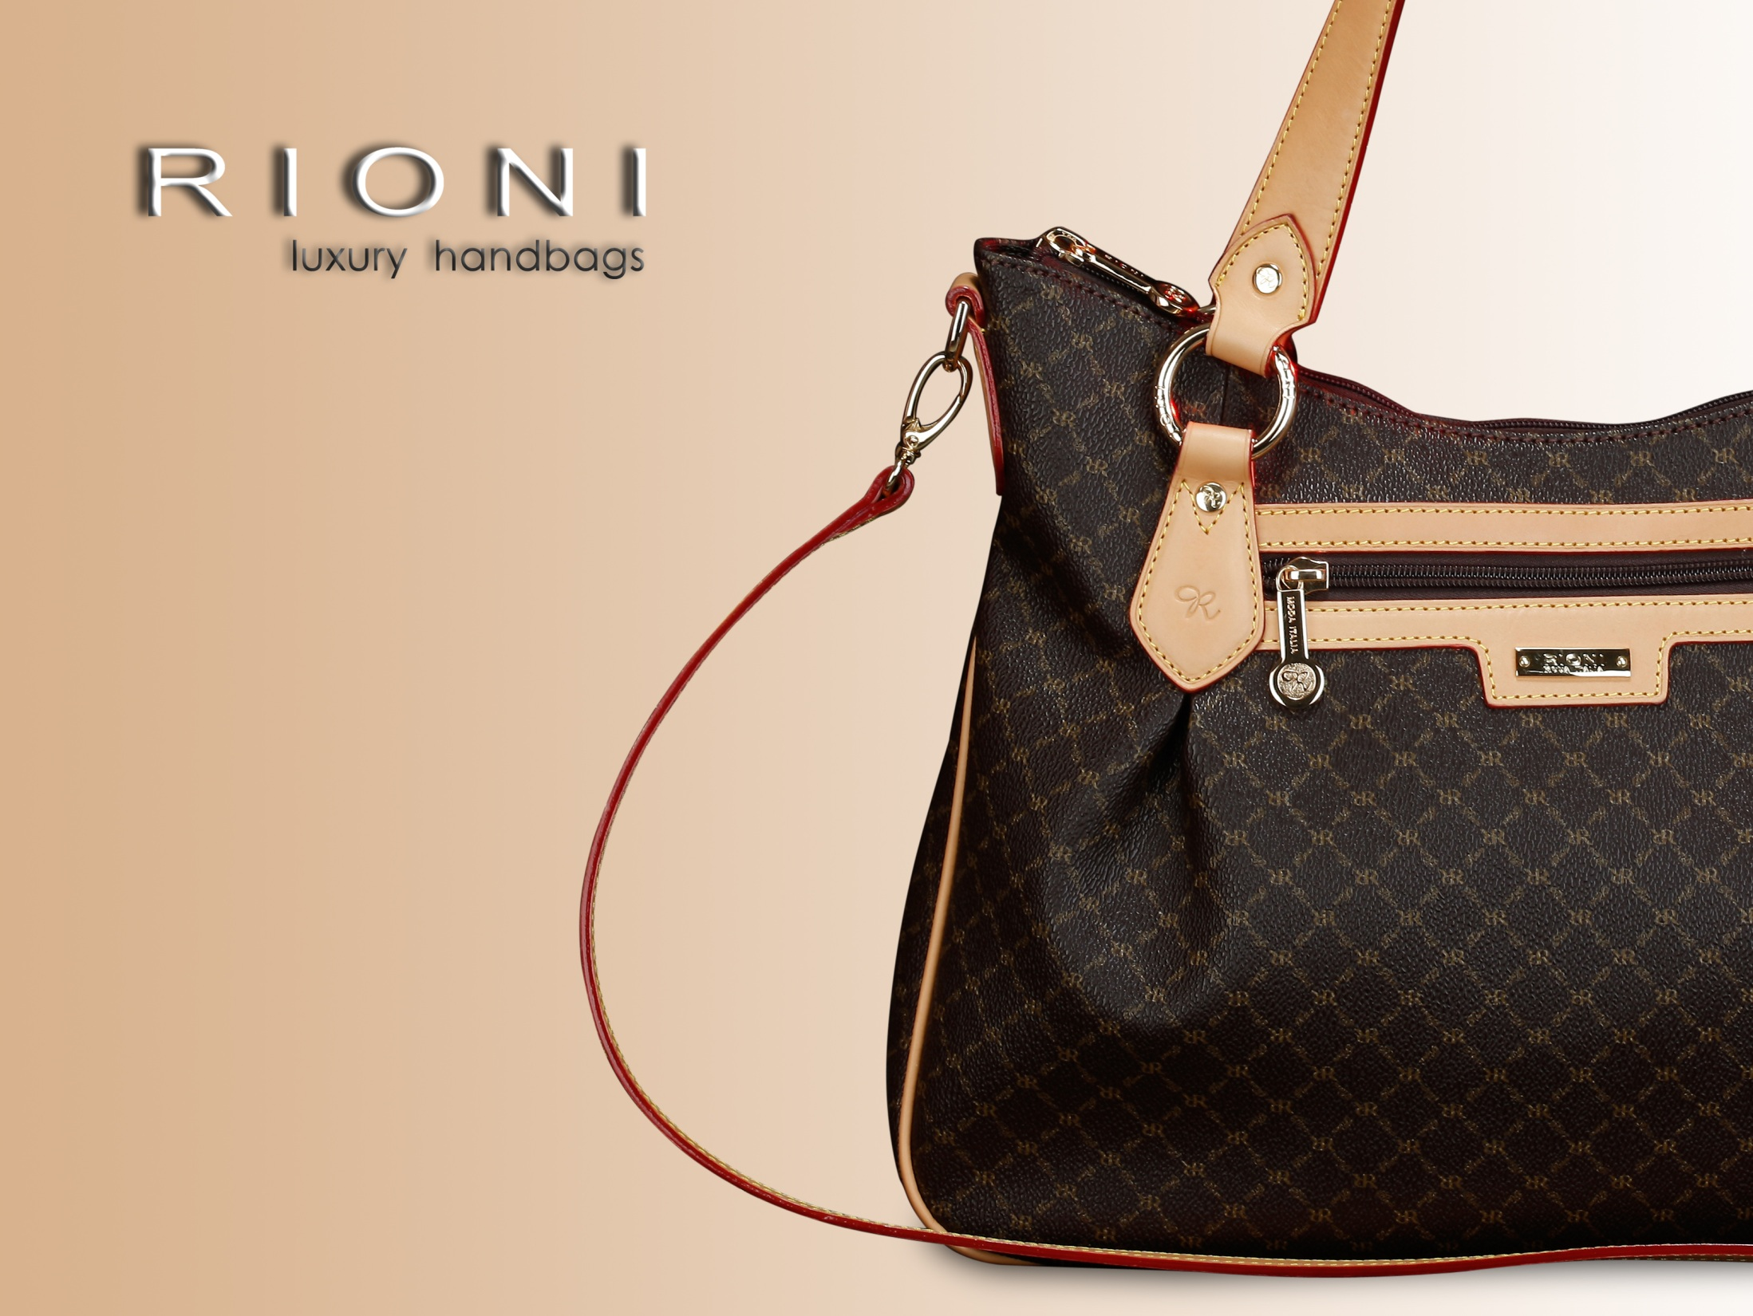

Slide 2
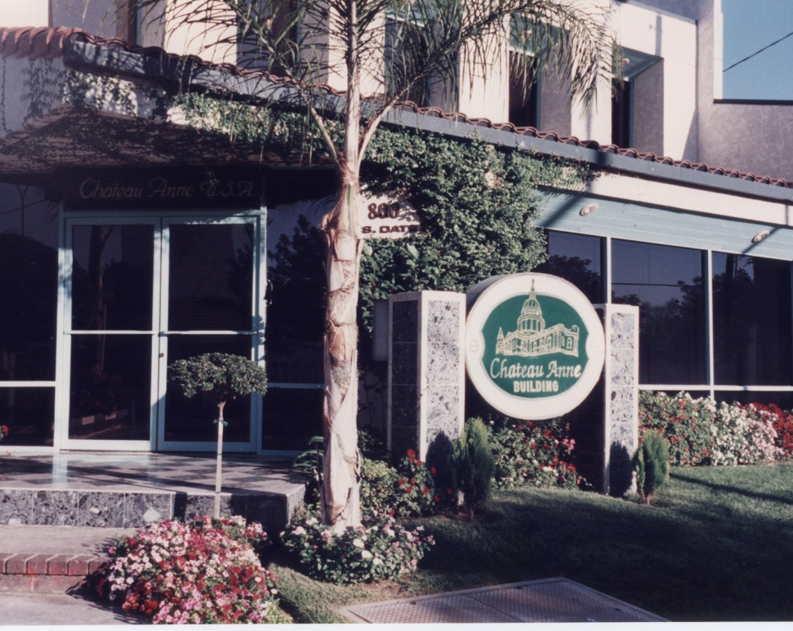
History
- Italian leather house
- Originates from Rome, Italy
- Recently celebrated 31st Anniversary
Distribution Center for Rioni, Alhambra, CA
June 18th, 1990

Slide 3
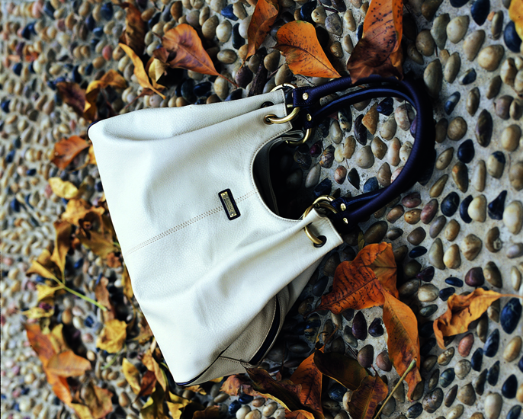
Luxury that never goes out of style.

Slide 4
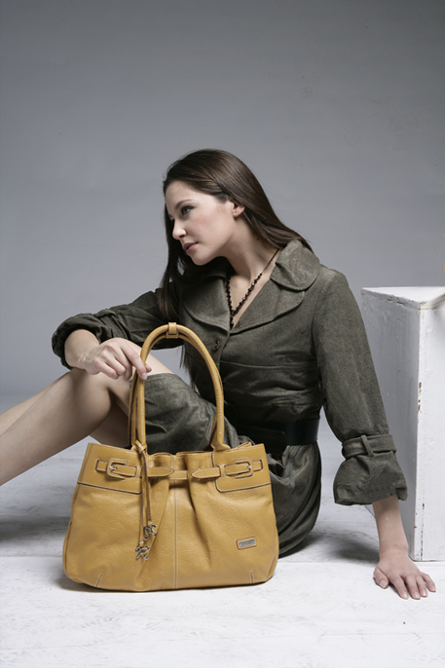
Benefits
Reasonable Price
Premium Quality
Excellent Durability
Convenient Use
Elegant Styling
1 Year Warranty

Slide 5
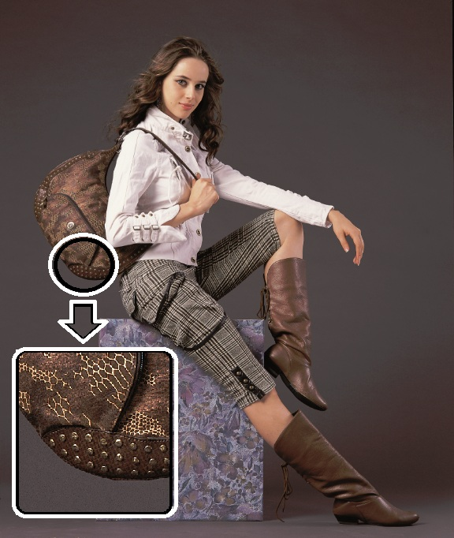
Quality
Needle work
  Double Stitching
  Pattern Sewing
Laminate Glue
  Color
Attention to Detail
  Premium Hardware
Full Grain Leather
  Differences (cont…)

Slide 6
Leather
Full Grain - Italian Vachetta Leather
Others – Leather or not?
Benefits
  Untreated
  Natural Feel
  Patina
  Carving
  Strength, Durability, Breathability
Skilled craftsman
White gloves manufacturing
Much cheaper
  Dyes
  Plastic Feel
  No Patina
  No Carving
  No / Less Strength, Durability, Breathability
Plastic backing
Simple Stitching

Slide 7
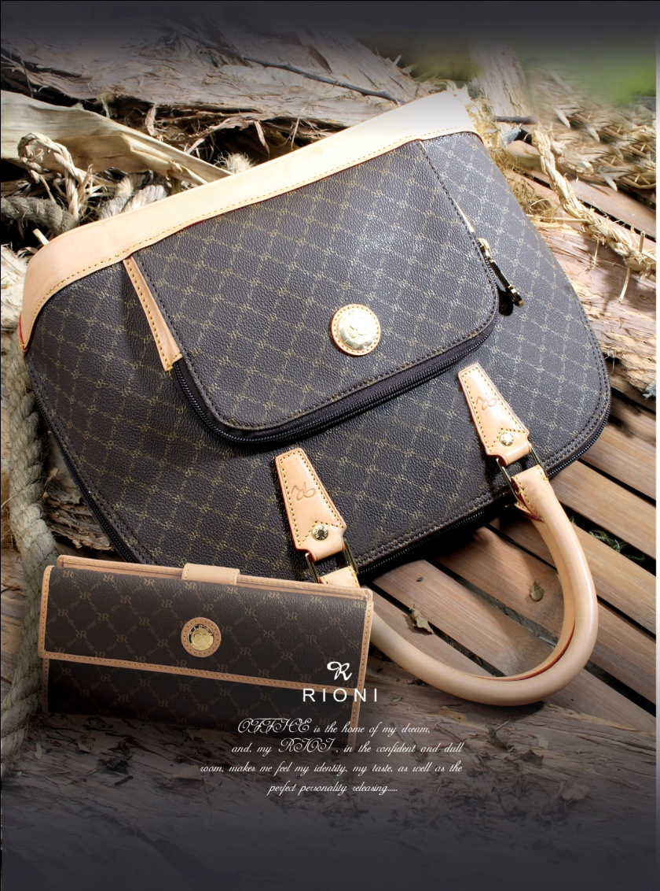
Patina
Patina
Color gains a rich patina over time
Women recognize this to be a luxury status symbol
Primary Concerns
  Matching with wallets
  Matching with luggage

Slide 8
Monogram Canvas
Body of (many) Rioni handbags are made of coated canvas.
Features
  Not susceptible to liquids and stains
  Easy to maintain
  Durable
  Sturdy yet Soft
  Monogram on body

Slide 9
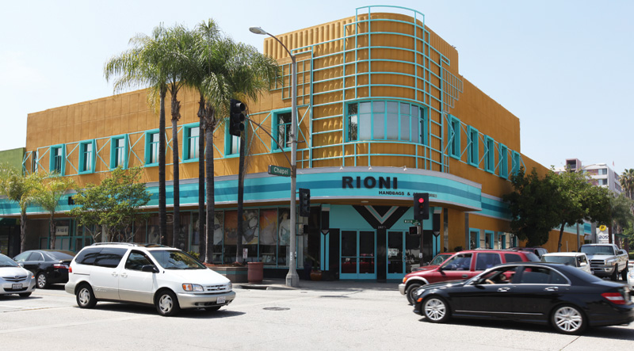
Translation
Moda Italia
  Translates to “of Italian Fashion Sense”
    A tribute to Rioni’s history
    Rioni Store
    Los Angeles,
    California

Slide 10
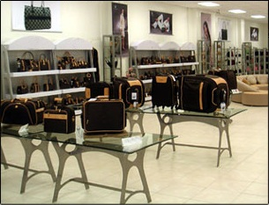
Production
Italy, Portugal, and China
Imported from Europe
Strict Manufacturing Standards
Carefully Supervised
Environmentally-safe
Ethical Principles

